Slide 1

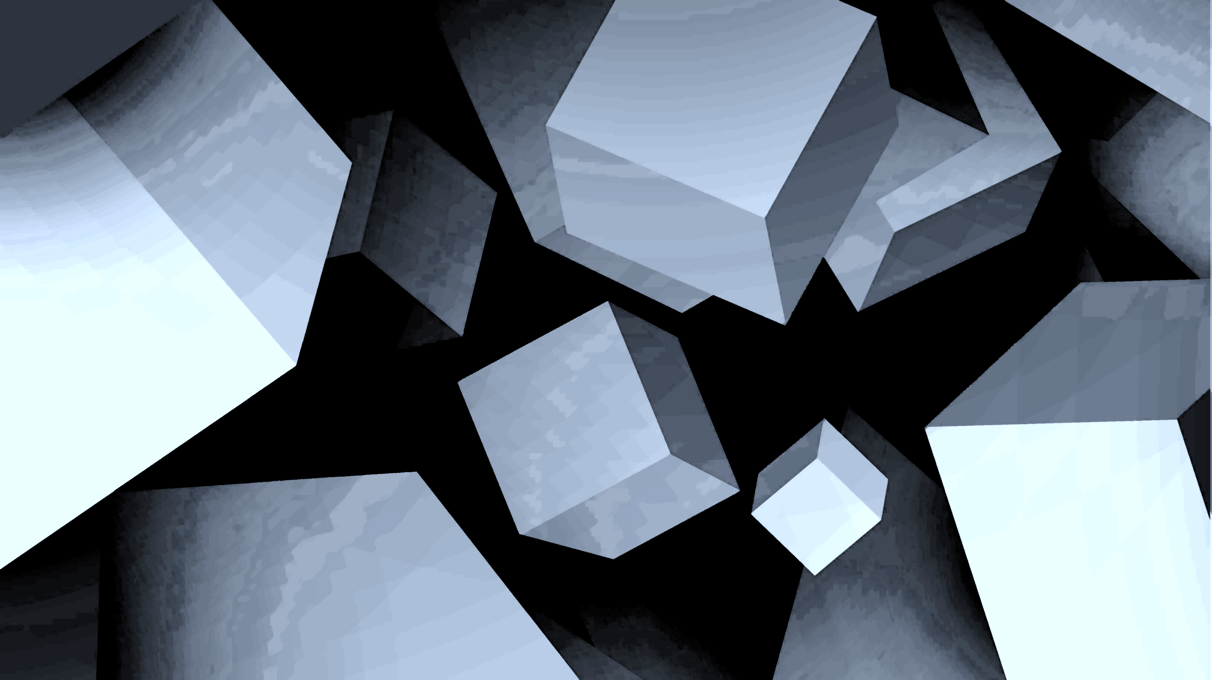
Dungeons and cards
Ian Aguilar Ramírez
Daniel Méndez Sierra
David Muñoz Peña
Andrik Yahir Rosado

Slide 2
Description
Objective: to develop a prototype for a roguelike deck-builder game in which the player will fight using cards, improve their deck and explore a dungeon. It will contain: an enemy, one instance of combat, 30 cards, 4 types of consumable objects, inventory system, a protagonist with movement and the dungeon.
Relevance: videogames have become increasingly relevant in the last decade, especially due to the rise of mobile games. At the same time, indie games (such as roguelikes) have benefitted from this increase in popularity, making them oftentimes very profitable.
Limitations: the project won’t be a fully fledged game, but a prototype (MVP) that shows the functioning of the combat system using cards against an enemy.

Slide 3
User stories (Exploration Phase)
User story 1: movement on the stage
The player must be able to move orthogonally around the stage.
User story 2: pick up objects during the exploration phase
The player must be able to pick objects up from the dungeon’s floor in order to use them during gameplay.
User story 3: inventory management
The player must be able to move around and eliminate cards and objects from their inventories.
User story 4: transition from Exploration Phase to Combat Phase
The player must be able to switch from the Exploration Phase to the Combat Phase by getting within range from an enemy (three tiles).

Slide 4
User stories (Combat Phase)
User story 5: select cards before combat
The player must be able to choose 20 cards at the start of the combat phase in order to use them during the fight.
User story 6: combat
The player must be able to use their cards during combat against enemies in order to defeat them or assist themselves with additional HP using consumables. The player must be able to lose HP, as well as the enemy.
User story 7: transition from Combat Phase to Exploration Phase
The player must be able to switch from the Combat Phase to the Exploration Phase after defeating an enemy in order to continue exploring the dungeon and fight other enemies.

Slide 5
User stories and non-functional requirements
User story 8: view and hide the player’s inventory
To be able to view the player’s available objects and hide them from view.
Non-functional requirements
The game:
will be programmed on C# using Unity.
shall be executable on Windows.
shall be executed by one user at a time.

Slide 6

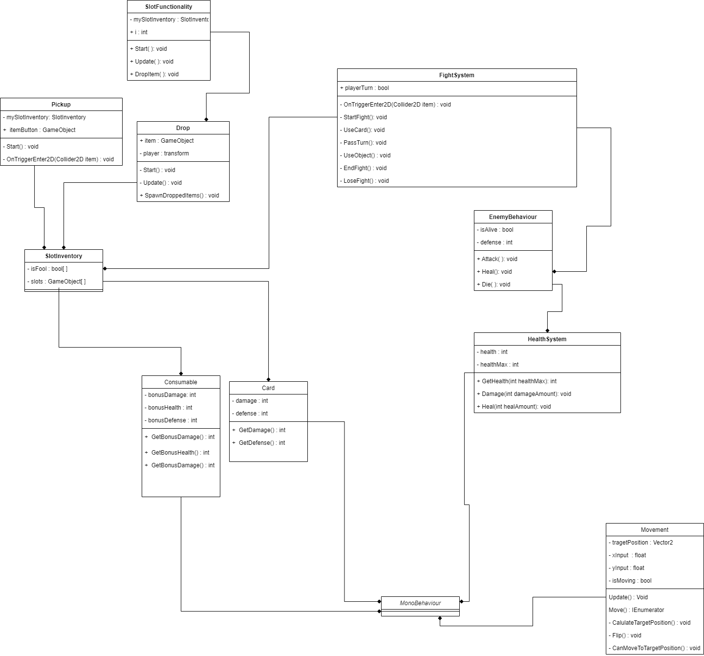
Class diagram
C

Slide 7
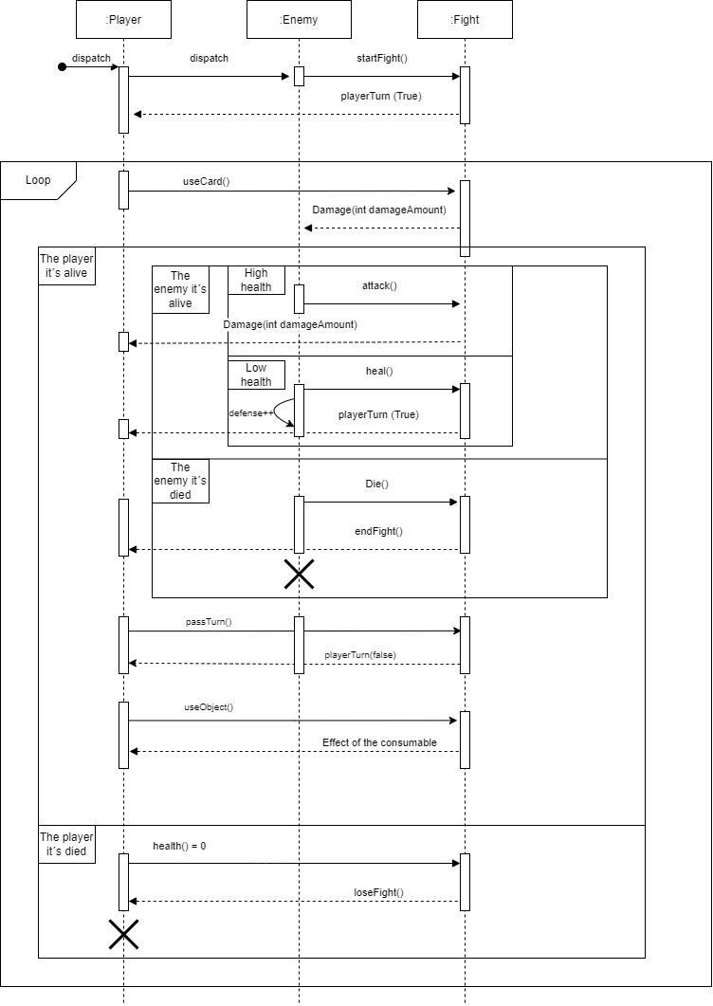
Sequence diagram

